Slide 1


HDFS-Based Large-Scale Healthcare Data Storage and Retrieval System CSA1522-CLOUD COMPUTING AND BIG ANALYTICS
PRESENTED BY
S.BLESSIKA(192525251)
M.KYATHI SAI PRIYA(192572101)
E.B ASHWINI(192511422)

Slide 2
Table of Contents (cont..)
S.NO | List of Contents
1. | Introduction
2. | Abstract
3. | Problem Statement
4. | Objectives
5. | Literature Review
6. | Methodology
7. | System Architecture
8. | Modue 1
9. | Implementation of Module 1
10. | Module 2
11. | Implementation of Module 2
12. | Module 3
13. | Implementation of Module3
14. | Advantages and Limitations

Slide 3
Table of Contents
S.NO | List of Contents
15. | Real-WorldApplications
16. | Future Scope
17. | Conclusion
18. | References
19. | References (cont..)

Slide 4
Introduction
Healthcare generates large amounts of data every day.
Data includes EHRs, medical images, lab reports, and sensor data.
Traditional storage has capacity and scalability limitations.
HDFS stores data across multiple computers.
Data is divided into blocks and replicated for reliability.
HDFS provides scalable and fault-tolerant storage.
It supports fast retrieval and healthcare data analysis.

Slide 5
Abstract
The proposed system provides a distributed platform for healthcare data management.
It handles structured and unstructured medical data efficiently.
HDFS enables data to be stored across multiple nodes.
The system improves data availability and reliability.
It allows healthcare organizations to manage growing datasets easily.
It supports secure and efficient access to medical information.
The system can be used for hospital management, research, and healthcare analytics.

Slide 6
Problem Statement
Healthcare organizations generate a large amount of data every day, including patient records, medical images, laboratory reports, prescriptions, and sensor data.
Traditional storage systems may not be able to efficiently handle this continuously increasing data because of limited storage capacity, scalability issues, and the risk of data loss.
Healthcare data also needs to be available quickly and stored securely.

Slide 7
Objectives
To store large volumes of healthcare data using HDFS.
To improve scalability by allowing additional storage nodes to be added easily.
To provide fault tolerance through data replication across multiple nodes.
To enable faster retrieval of patient records and medical data.
To reduce data loss caused by hardware or server failures.
To provide a cost-effective solution for large-scale healthcare data storage.

Slide 8
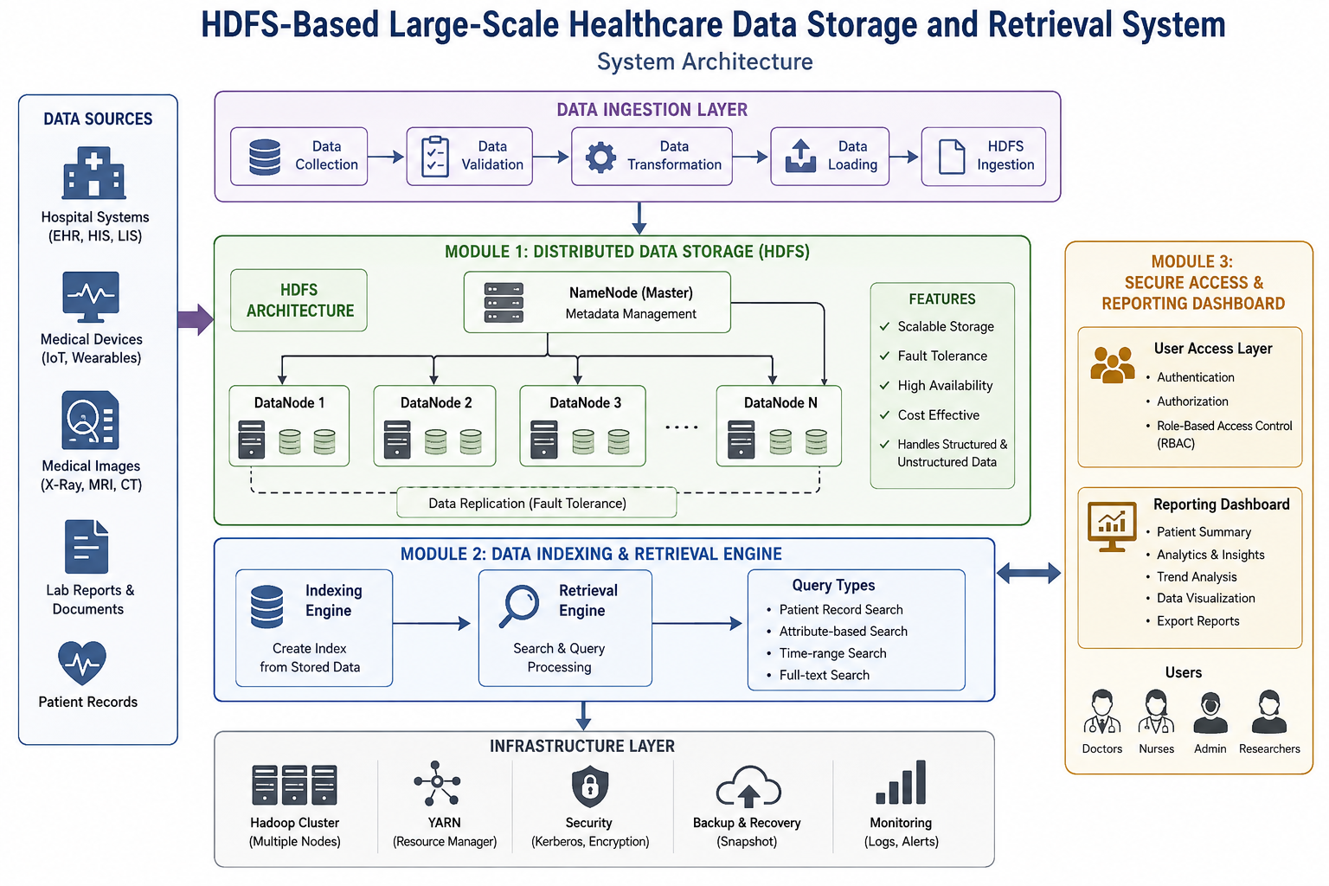
SYSTEM ARCHITECTURE

Slide 9
Methodology
1. Healthcare Data Collection
Collect healthcare data such as patient records, laboratory reports, medical images, prescriptions, and sensor data from different sources.
2. Data Preprocessing
Organize and prepare the collected data by removing unnecessary or duplicate information and arranging it in a suitable format.
3. Data Storage Using HDFS
Upload the healthcare data into HDFS, where large files are divided into smaller blocks and distributed across multiple DataNodes.

Slide 10
Methodology
4. Data Replication
Create multiple copies of data blocks to ensure fault tolerance and data availability if a storage node fails.
5. Data Indexing
Create indexes and metadata to help locate healthcare records quickly based on details such as Patient ID, date, or record type.
6. Secure Data Access
Implement user authentication and role-based access control to ensure that only authorized users can access sensitive healthcare information.

Slide 11
Literature Review
Author | Year | Study | Key Finding
Imran et al. | 2021 | Studied big-data analytics in | Hadoop and big-data technologies help manage large healthcare datasets efficiently.
Awrahman et al. | 2022 | Reviewed the role of big data in healthcare. | Healthcare big data improves data management and decision-making, but security remains a challenge.
Khan et al. | 2022 | Studied healthcare big-data analytics for efficient care | Big-data analytics supports efficient healthcare services and disease diagnosis.
Elragal et al. | 2023 | Studied healthcare big-data analytics for efficient care | Big data, AI, and ML can improve healthcare analytics and patient care.
Dharmawan et al. | 2023 | Studied big-data capabilities in hospitals | Proper data infrastructure and storage capabilities are important for hospital analytics.

Slide 12
Module 1: Distributed Data Storage (HDFS)
Data Collection: Collects patient records, medical images, lab reports, and sensor data.
Data Division: Large healthcare files are divided into smaller blocks.
Distributed Storage: Blocks are stored across multiple Data Nodes.
Name Node: Maintains file metadata and tracks block locations.
Data Replication: Creates multiple copies of blocks to prevent data loss.
Fault Tolerance: Data remains available even if a DataNode fails.
Scalability: More DataNodes can be added when healthcare data increases.

Slide 13
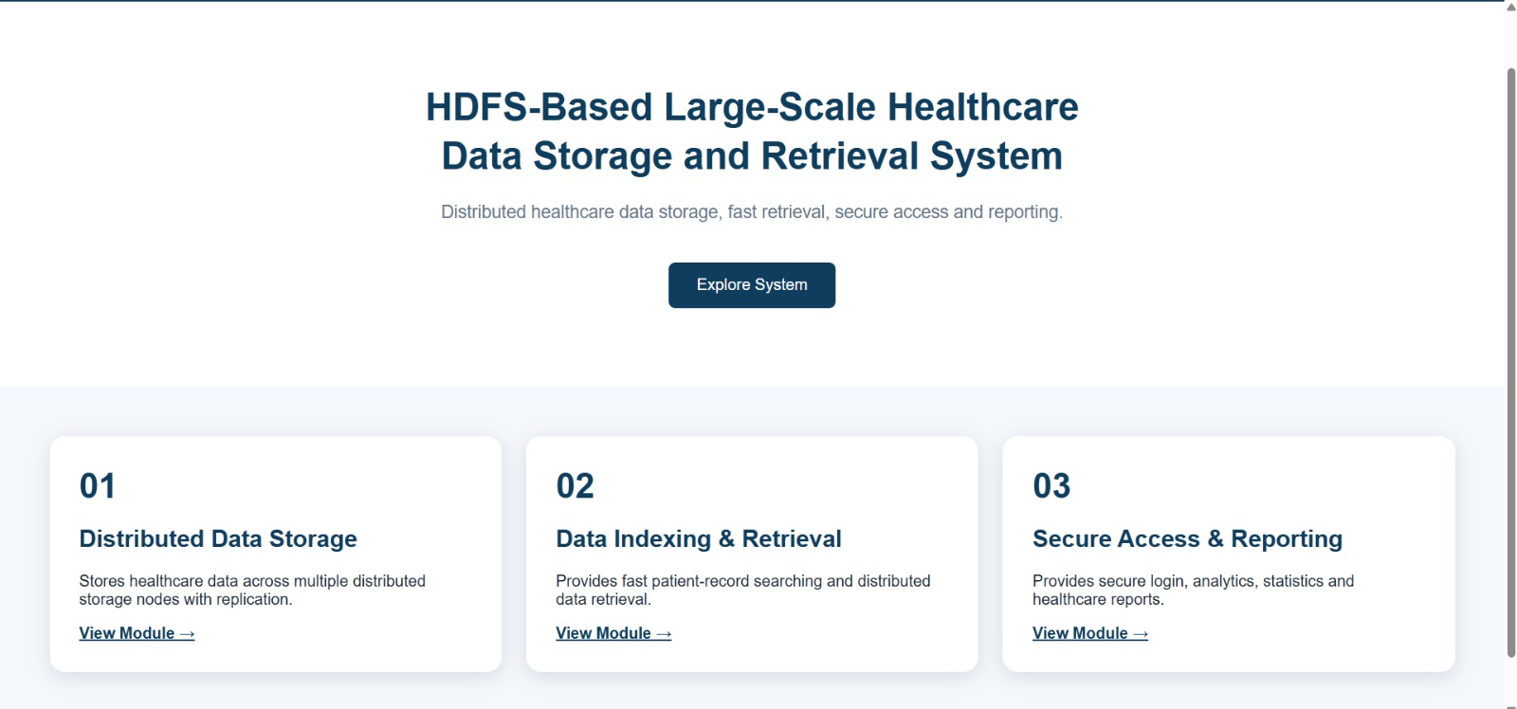
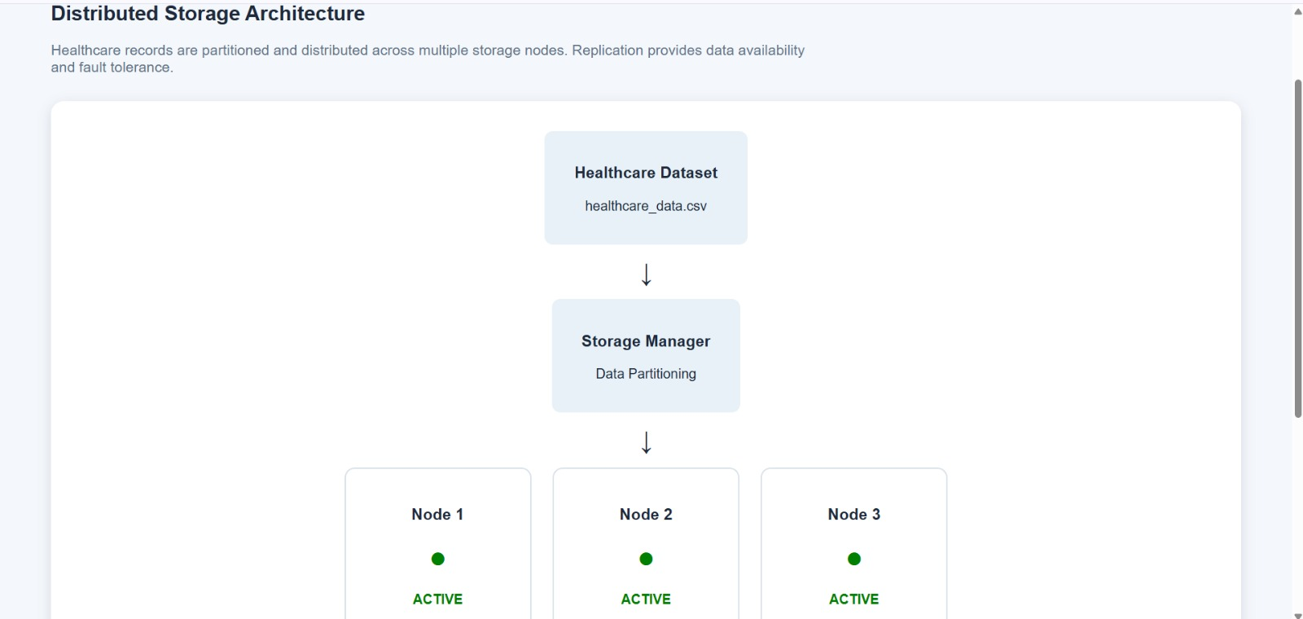
Implementation of Module 1

Slide 14
Module 2: Data Indexing & Retrieval Engine
Data Indexing: Creates indexes for quick access to healthcare records.
Metadata Management: Stores information about patient files and data locations.
Search Processing: Searches records based on patient ID, date, type, etc.
Fast Retrieval: Locates and retrieves required data efficiently.
Query Handling: Processes user requests for specific healthcare data.
Data Filtering: Retrieves only the required records from large datasets.
Efficient Access: Reduces search time and improves overall system performance.

Slide 15
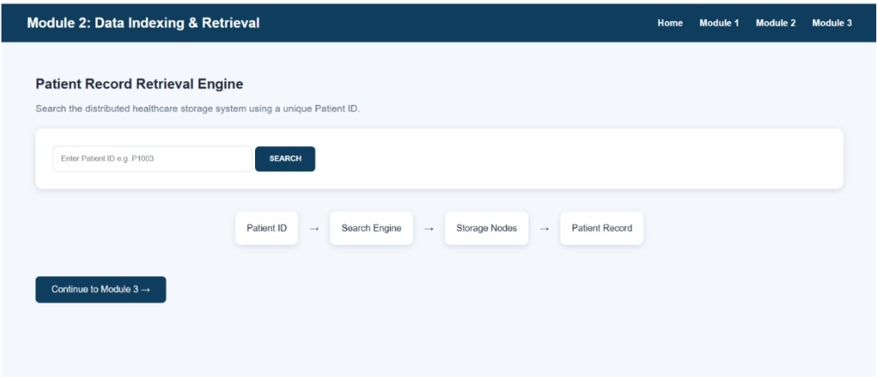
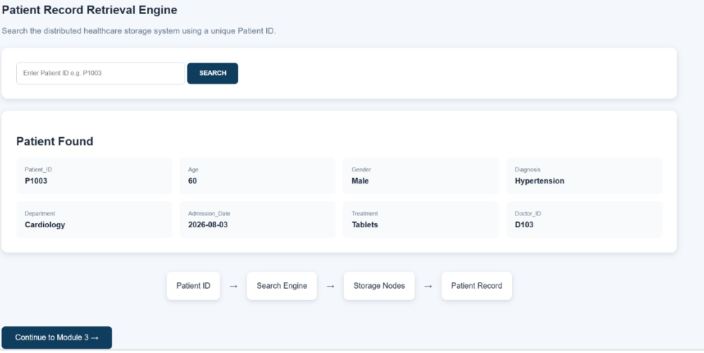
Implementation of Module 2

Slide 16
Module 3: Secure Access & Reporting Dashboard
User Authentication: Verifies authorized healthcare users.
Role-Based Access: Provides access based on user roles.
Data Security: Protects sensitive patient information.
Dashboard: Displays healthcare data in a simple interface.
Report Generation: Creates reports from stored data.
Data Visualization: Shows important information using charts and graphs.
Activity Monitoring: Tracks user access and system activities.

Slide 17
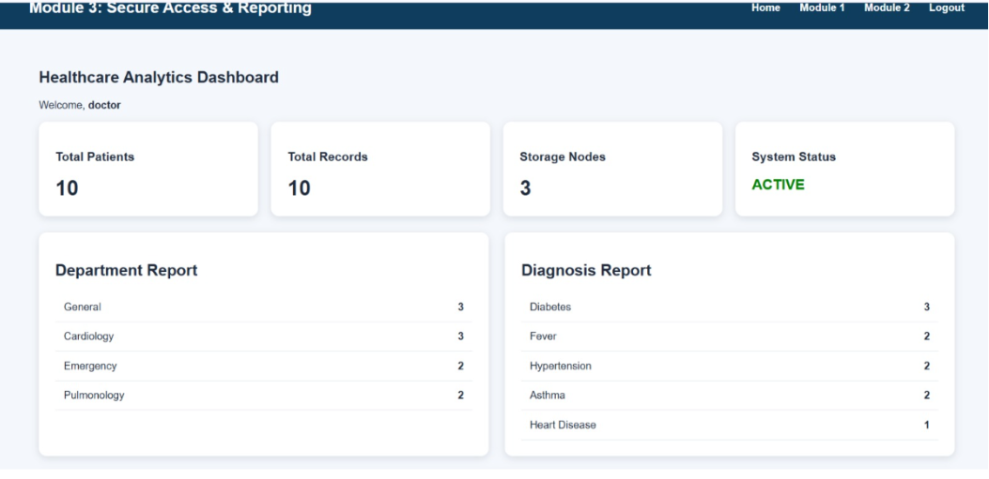
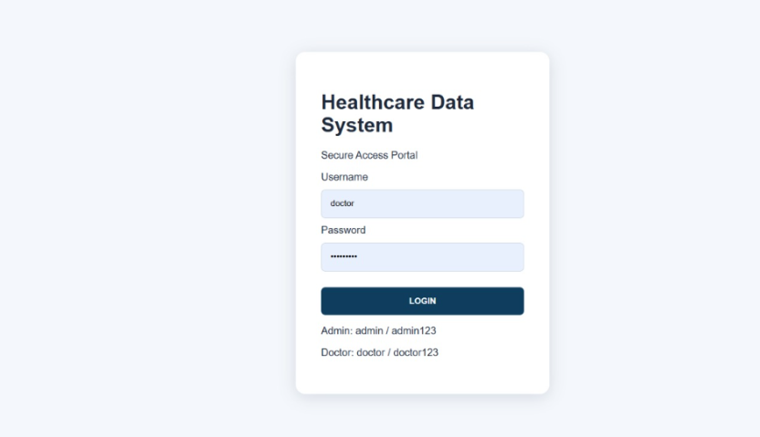
Implementation of Module 3

Slide 18
Advantages and Limitations
Limitations
Complex setup and management.
Requires technical expertise.
Security and privacy must be carefully managed.
Not suitable for many small files.
Requires regular monitoring and maintenance.
Not ideal for extremely low-latency transactions.
Advantages
High scalability.
Fault tolerance.
Large data storage capacity.
High data availability.
Cost-effective storage.
Distributed data processing.
Suitable for large healthcare datasets.
.

Slide 19
Real-World Applications
Electronic Health Records (EHR)
Medical image storage
Laboratory reports
Hospital management
Remote patient monitoring
Healthcare analytics
Medical research
Disease pattern analysis

Slide 20
Conclusion
HDFS provides a scalable and reliable solution for healthcare data.
Distributed storage handles very large datasets.
Replication improves data availability and fault tolerance.
It can support hospitals, research centers, and healthcare organizations.
HDFS helps manage the continuously increasing volume of healthcare data.

Slide 21

References (cont..)
[1] K. Shvachko, H. Kuang, S. Radia, and R. Chansler, “The Hadoop Distributed File System,” in Proc. IEEE 26th Symp. Mass Storage Systems and Technologies (MSST), Incline Village, NV, USA, 2010, pp. 1–10.
[2] J. Dean and S. Ghemawat, “MapReduce: Simplified data processing on large clusters,” Communications of the ACM, vol. 51, no. 1, pp. 107–113, Jan. 2008.
[3] T. White, Hadoop: The Definitive Guide, 4th ed. Sebastopol, CA, USA: O’Reilly Media, 2015.
[4] M. Chen, S. Mao, and Y. Liu, “Big data: A survey,” Mobile Networks and Applications, vol. 19, no. 2, pp. 171–209, Apr. 2014.
[5] A. Katal, M. Wazid, and R. H. Goudar, “Big data: Issues, challenges, tools and good practices,” in Proc. 6th Int. Conf. Contemporary Computing (IC3), Noida, India, 2013, pp. 404–409.

Slide 22
References
[6] M. Raghupathi and W. Raghupathi, “Big data analytics in healthcare: Promise and potential,” Health Information Science and Systems, vol. 2, no. 1, pp. 1–10, Feb. 2024.
[7] W. Raghupathi and V. Raghupathi, “Big data analytics in healthcare: A review of the current state of research,” Journal of Medical Systems, vol. 39, no. 3, pp. 1–10, Mar. 2015.
[8] C. Lee, T. Li, and M. K. P. So, “A review of healthcare big data analytics,” in Proc. IEEE Int. Conf. Big Data, Washington, DC, USA, 2014, pp. 1–8.
[9] N. Khan, I. Yaqoob, I. A. T. Hashem, Z. Inayat, W. K. M. Ali, M. Alam, M. Shiraz, and A. Gani, “Big data: Survey, technologies, opportunities, and challenges,” The Scientific World Journal, vol. 2014, Art. no. 712826, 2014.
[10] M. Viceconti, P. Hunter, and R. Hose, “Big data, big knowledge: Big data for personalized healthcare,” IEEE Journal of Biomedical and Health Informatics, vol. 19, no. 4, pp. 1213–1217, Jul. 2015.

